Slide 1
BOOLEAN ALGEBRA
Presented by :
S. S. MANI
PGT (Comp.Sc)
K.V.No 3, ONGC
ONGC Nagar
SURAT

Slide 2
Binary Valued Quantities
Binary Decision : The Decision which results
into either YES (TRUE) or NO (FALSE) is
called Binary Decision
Ex: 1. 13-2=11
2. Delhi is the biggest state in India.
3. Should I take the book. ?
4. Did you see him ?

Slide 3
Boolean Algebra
Boolean algebra is a mathematical system for the manipulation of variables that can have one of two values.
  In formal logic, these values are “true” and “false.”
  In digital systems, these values are “on” and “off,” 1
  and 0, or “high” and “low.”

Slide 4
Logical Statements :
Consider the following statements:
I want to have tea | T | T | F | F
Tea is readily availabe | T | F | T | F
Result : | T | F | F | F
This can be represented by using a tabular form using all the input constraints, called Truth Table.

Slide 5
  TRUTH TABLE :
  Table which represents all the possible values of logical variables / statements along with all the possible results of the given combinations of values
  If the result of any logical statement or expression is always TRUE or 1, it is called TAUTOLOGY
  If the result of any logical statement or expression is always FALSE or 0, it is called FALLACY.

Slide 6
LOGICAL OPERATIONS
A logical value for a variable A can is either TRUE or FALSE.
Based on this there are three basic logic operations.
Viz.
  NOT (Complement) changes TRUE to FALSE, and v.v. (A’, /A, )
  AND — “A AND B” is true if A and B are individually true (A•B, AB, A&B, A.B)
  OR — “A OR B” is true if either A or B is true (both may be true) (A+B, A|B, A.B).
  These logical operations are performed using Logical Operators
  Namely, NOT Operator, AND Operator, OR Operator

Slide 7
BOOLEAN EXPRESSION :
When logical variables are combined by
means of logical operators( AND,OR,NOT)
to form Boolean Expression.
Ex : W = X + YZ
A= B+C+D+EF
These expressions can be solved by using
Truth Table and also by different methods

Slide 8
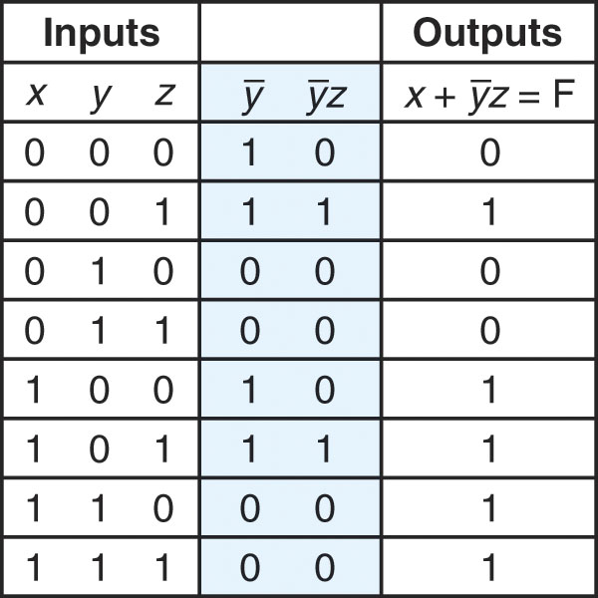
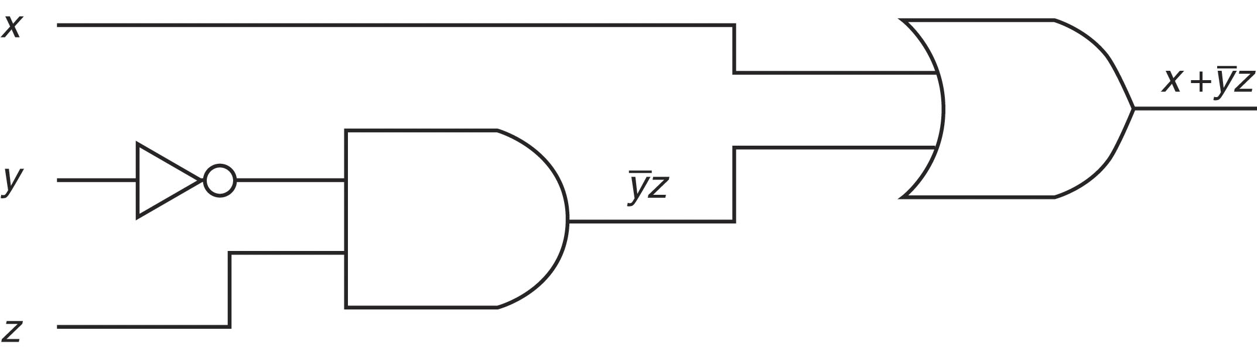
Example
F(1,4,5,6,7) = P(X,Y,Z) X’Y’Z+XY’Z’+XY’Z+XYZ’+XYZ
= X’Y’Z + XY’(Z’+Z)+XY(Z’+Z) (:. Z+Z’=1)
= X’Y’Z+XY’+XY
0
1 = X’Y’Z+X(Y+Y’) (:.Y+Y’=1)
2 = X’ Y’Z +X (TAKE X’=Y & Y’Z=Z)
3 = (X+X’)(Y’Z+X)
4
= 1*(X+Y’Z)
5
6 = X+Y’Z
7

Slide 9
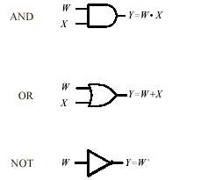
LOGIC GATE :
Definintion : Gate is an electronic circuit which operates on one or more signals to produce an output signal

Slide 10
The three simplest gates are :
1. AND GATE : can have 2 or more than 2 input signals and produce 1 output signal. When all the inputs are 1 i.e. High then the output is 1 otherwise output is 0 only.
2. OR GATE : has 2 or more than 2 input signals and produce 1 output signal. If any of the inputs is 1 i.e. High the output is 1 or high
3. NOT GATE (INVERTER)
  has only one input signal and one output signal
  And the output state is always the opposite of the
  input state.

Slide 11
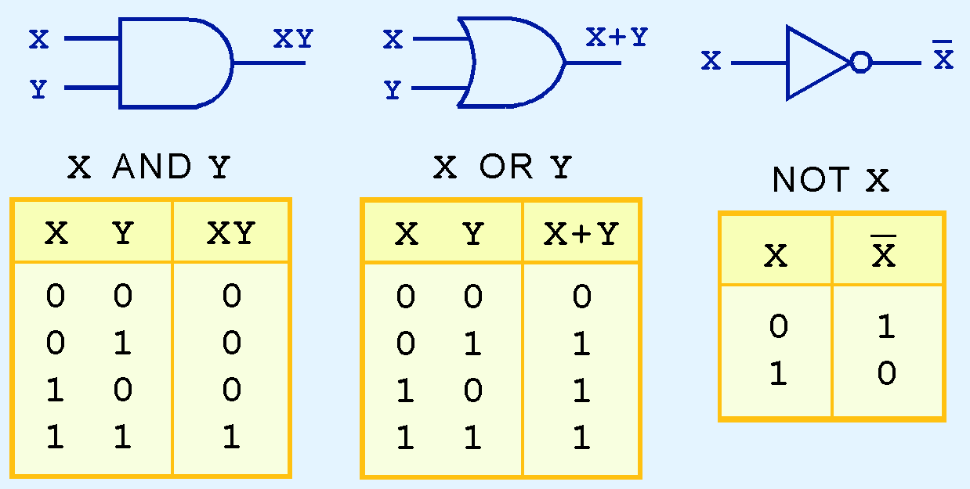
THREE BASIC GATES
AND OR NOT

Slide 12
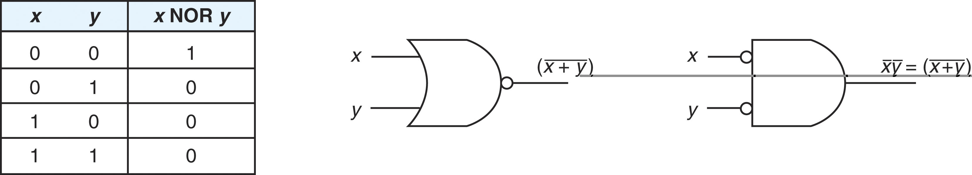
NOR : It has two or more input signals but only one output signal. If all the inputs are 0 (i.e low) then the output signal is 1 ( high).
UNIVERSAL GATES
NOR Gate
Algebric Function :
F= (X+Y)’

Slide 13
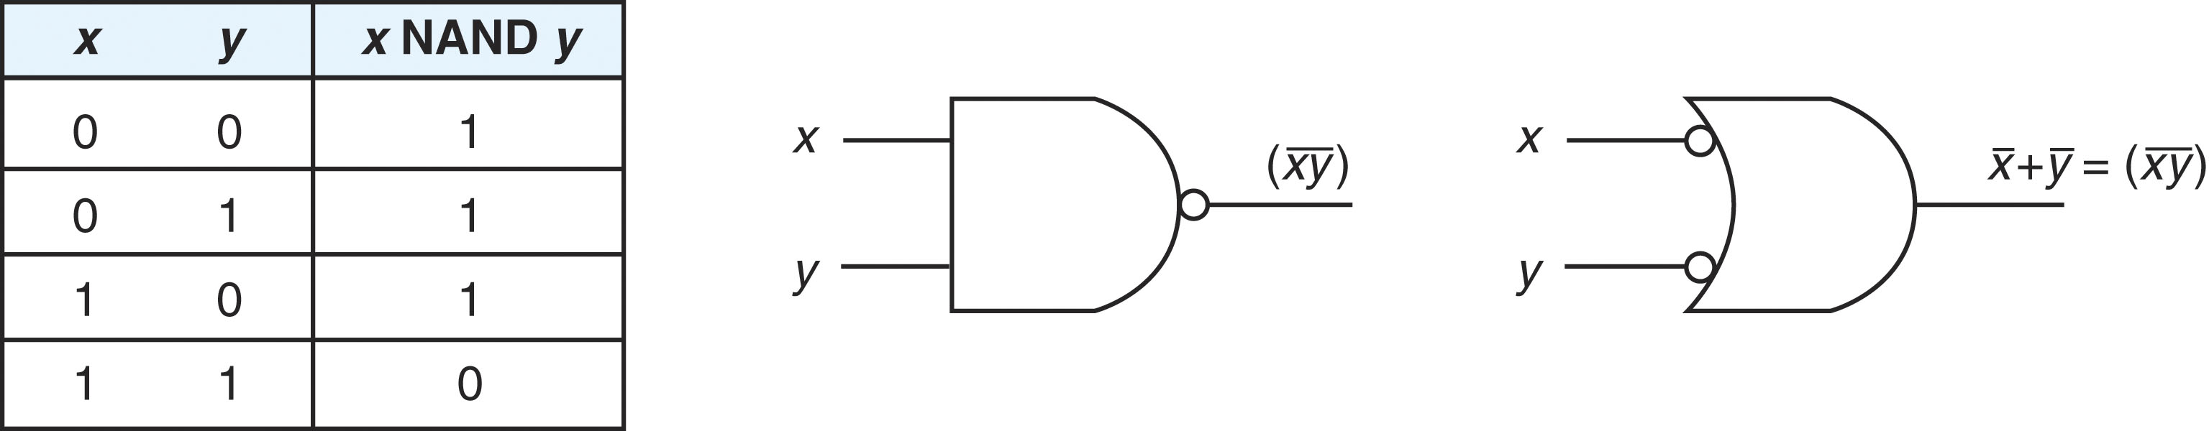
NAND : It has two or more input signals but only one output signal. If all the inputs are 1 (i.e high) then the output signal is 0 (low).
NAND Gate
Algebric Function :
F= (XY)’

Slide 14
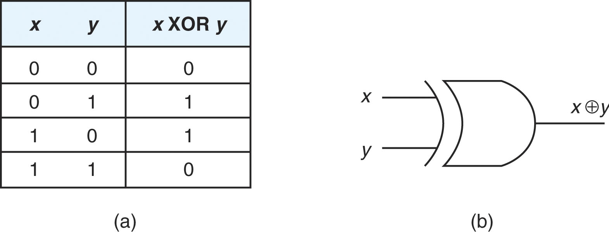

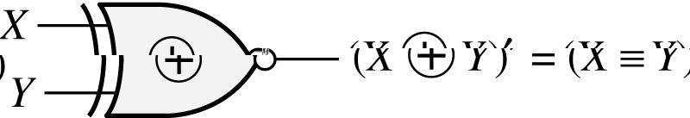
XOR & XNOR gates
Exclusive-OR (XOR) Gate :
Truth Tables :
Algebric Function
F = X’Y + XY’
Exclusive-NOR (XNOR) Gate :
Truth Tables :
Algebric Function
XY
0 0
0 1
1 0
1 1
1
0
0
1
F = X’Y’ + XY

Slide 15
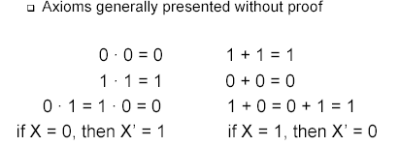
Basic Postulates of Boolean Algebra

Slide 16
PRICIPLE OF DUALITY
It states that Starting with a Boolean relation, another boolean relation can be derived by
1. Changing each OR sign(+) to a AND sign(.)
2. Changing each AND sign(.) to a OR sign(+)
3. Replacing each 0 by 1 and each 1 by 0.
Ex : 0+0=0 becomes 1.1=1 …..

Slide 17
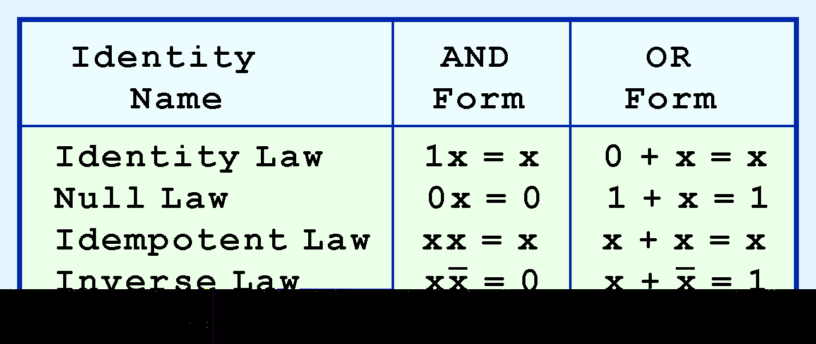
BOOLEAN ALGEBRA RULES

Slide 18
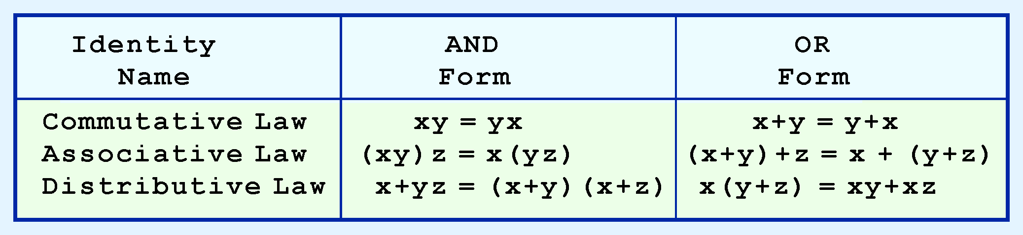
BOOLEAN ALGEBRA RULES

Slide 19
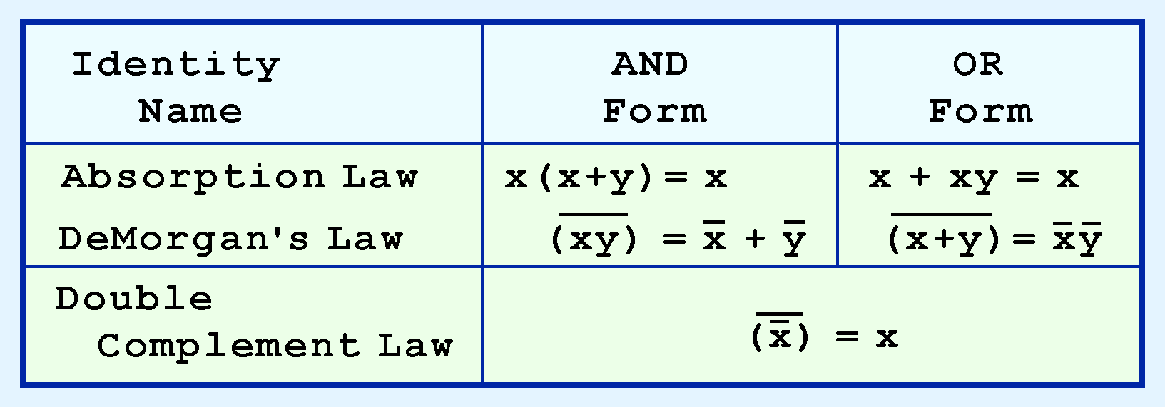
BOOLEAN ALGEBRA RULES
Or INVOLUTION LAW

Slide 20
DEMORGANS THEOREMS
De Morgan’s First Theorem :
It states that
De Morgan’s First Theorem :
It states that

Slide 21
THANK YOU ! ! ! !
S S MANI
PGT ( Comp.Sc)
K V No 3, ONGC
SURAT

